Slide 1
ANALYZING FACEBOOK ADS
DETERMINE WHETHER ADS ARE MAKING MONEY OR BURNING IT

Slide 2
There’s A LOT OF DATA out there…

Slide 3
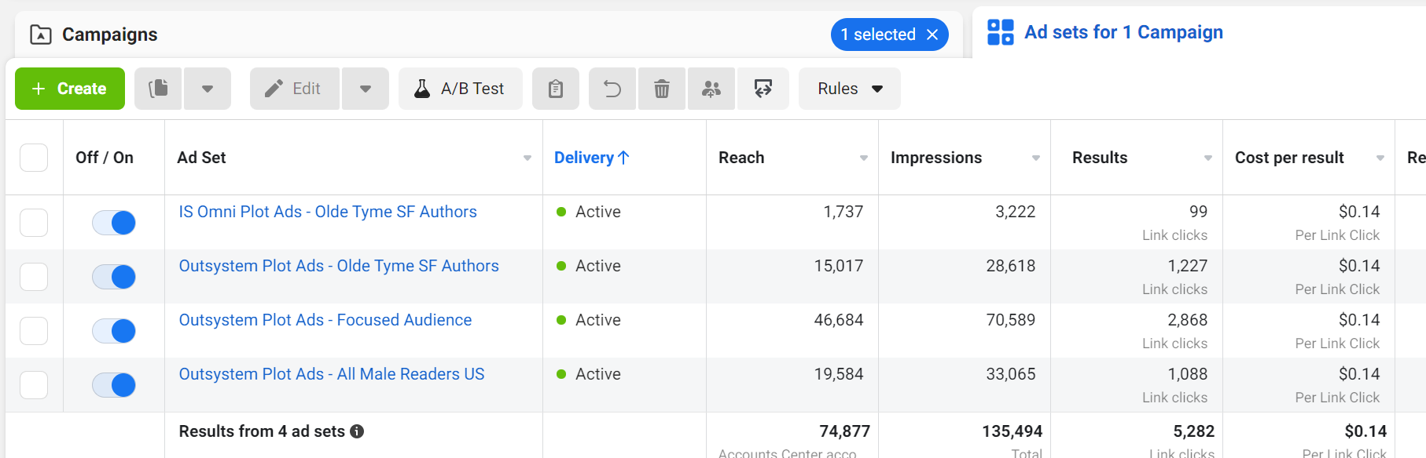
FACEBOOK PROVIDES A LOT OF DATA ABOUT OUR ADS

Slide 4
AND THIS IS BUT A FRACTION OF WHAT IS AVAILABLE

Slide 5
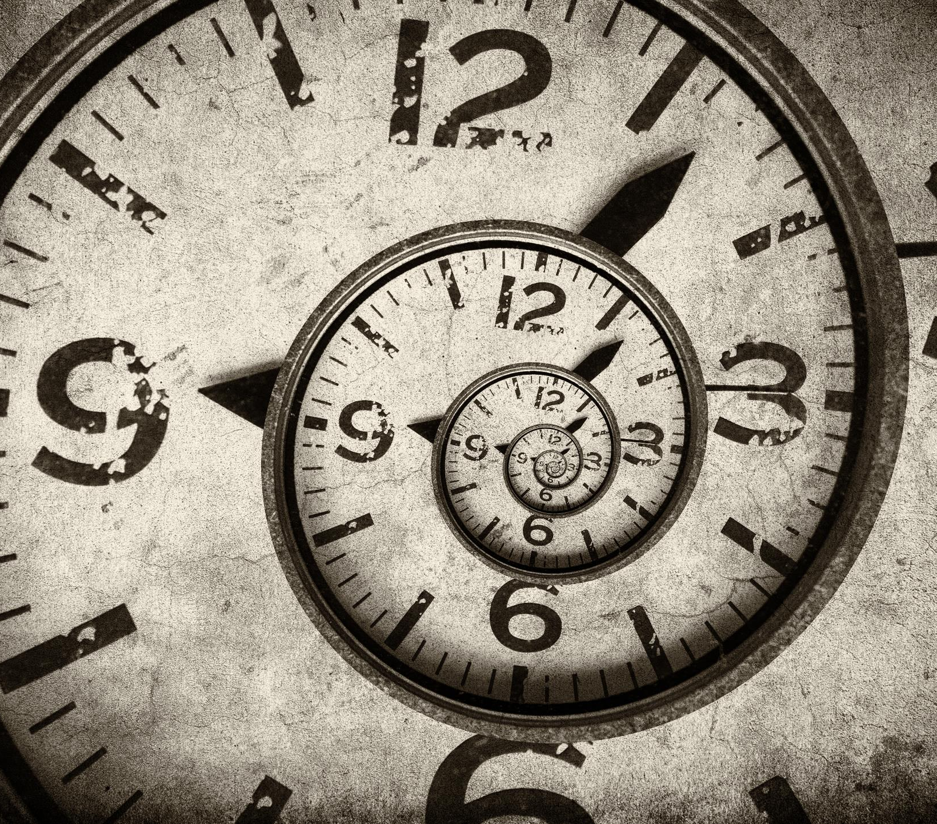
I’VE SPENT YEARS LOOKING AT THIS DATA IN AN EFFORT TO DETERMINE WHAT METRICS BEST INDICATE PERFORMANCE

Slide 6
UNDERSTANDING WHAT THE NUMBERS MEAN…
REACH
IMPRESSIONS
RESULTS
RESULT RATE
FREQUENCY
OUTBOUND CLICKS
COST PER RESULT (CPR)
COST PER CLICK
COST PER UNIQUE OUTBOUND CLICK

Slide 7
UNDERSTANDING WHAT THE NUMBERS MEAN…
REACH
Number of unique humans reached

Slide 8
UNDERSTANDING WHAT THE NUMBERS MEAN…
IMPRESSIONS
Number of times the ad has shown

Slide 9
UNDERSTANDING WHAT THE NUMBERS MEAN…
RESULTS
Number of times people did the result action

Slide 10
UNDERSTANDING WHAT THE NUMBERS MEAN…
RESULT RATE
Percentage of impressions that turned into results

Slide 11
UNDERSTANDING WHAT THE NUMBERS MEAN…
FREQUENCY
Average number of times a given person has seen the ad

Slide 12
UNDERSTANDING WHAT THE NUMBERS MEAN…
OUTBOUND CLICKS
Raw number of outbound clicks

Slide 13
UNDERSTANDING WHAT THE NUMBERS MEAN…
COST PER RESULT (CPR)
Cost per result action taken

Slide 14
UNDERSTANDING WHAT THE NUMBERS MEAN…
CPC (all)
Average cost of any click made anywhere on the ad or in the comments

Slide 15
UNDERSTANDING WHAT THE NUMBERS MEAN…
COST PER UNIQUE OUTBOUND CLICK
Cost per unique human clicking a link or button that leads off Facebook or Instagram

Slide 16
THERE’S A LOT OF NOISE

Slide 17
Here’s WHAT MATTERS…
COST PER RESULT (CPR)
RESULT RATE
FREQUENCY

Slide 18
ANALYZING COST PER RESULT

Slide 19
YOU’RE ACCEPTABLE CPR IS UNIQUE TO YOU
Work out Sell-Through Value
01
Determine how many clicks it takes to sell a book or get a borrow
02
Multiply your average CPR by the click to sale value
03

Slide 20
THE FORMULA
Cost per Result (r): $0.25
Clicks to Convert (c): 30
Cost to Sell (s): ?
r x c = s

Slide 21
THE FORMULA
Series Read-through Value: $6.50
CPC
Clicks
Cost
Profit
$0.25 x 30 = $7.50
-$1.00
$0.25 x 20 = $5.00
$1.50
$0.20 x 20 = $4.00
$2.50
$0.15 x 20 = $3.00
$3.50
$0.15 x 15 = $2.25
$4.25
$0.10 x 10 = $1.00
$5.50

Slide 22
ANALYZING COST PER RESULT
CPR > $0.30 – Ad has a serious issue
CPR < $0.05 – Ad could be showing to a bad audience
Mainstream Fiction Sweet Spot: $0.08 - $0.18
Genre Fiction Sweet Spot: $0.12 - $0.25

Slide 23
WHAT’S IN A RATE?

Slide 24
There’s one Rate to rule them all

Slide 25
Contemporary Romance: 8% - 20%
Mystery and Thriller: 6% - 14%
Genre Romance: 6% - 14%
Genre Fiction: 4% - 8%
Super Niche Fiction: 2% - 5%
THE RESULT RATE

Slide 26
WHY DOES MY RESULT RATE SUCK?

Slide 27
In essence, the Ad is not resonating with the audience.
Examine the audience first. If it looks spot on, take a look at the ad where…
WHY DOES MY RESULT RATE SUCK?

Slide 28
IMAGE is The
#1 Culprit

Slide 29
FREQUENCY IMPRESSIONS AND REACH
Oh my!

Slide 30
FREQUENCY IS Impressions divided by REACH

Slide 31
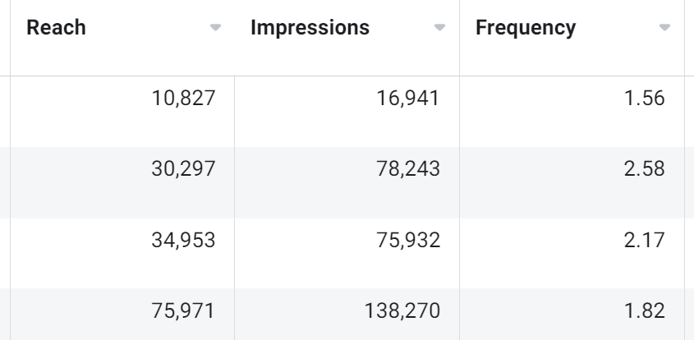

Slide 32
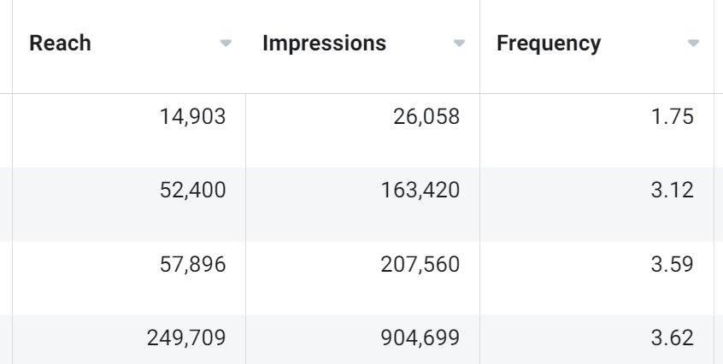

Slide 33
RESULT RATE
COST PER RESULT FREQUENCY

Slide 34
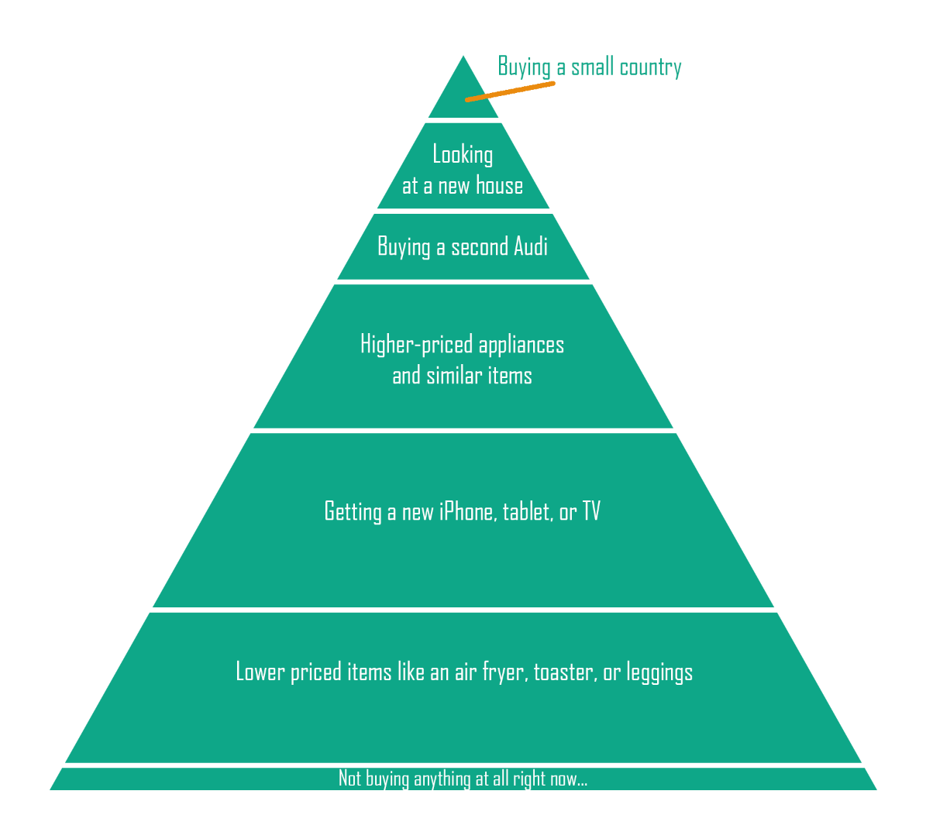

Slide 36
THANK YOU
Visit
www.thewritingwives.com/swss
…and receive a special offer!
MALORIE@THEWOODENPENPRESS.COM
JILL@THEWOODENPENPRESS.COM

